Slide 1
Devo substituir minha API Rest por GraphQL?
Gabriel Sussumu
Braspag

Slide 2

Gabriel Sussumu
Faeterj Petrópolis 2016 - 2016
Allen 2015 - 2017
Braspag 2017 -

Slide 3
Devo substituir minha API Rest por GraphQL?????

Slide 4
Não.

Slide 5
Application Programming Interface
Api
É um padrão de comunicação.

Slide 6
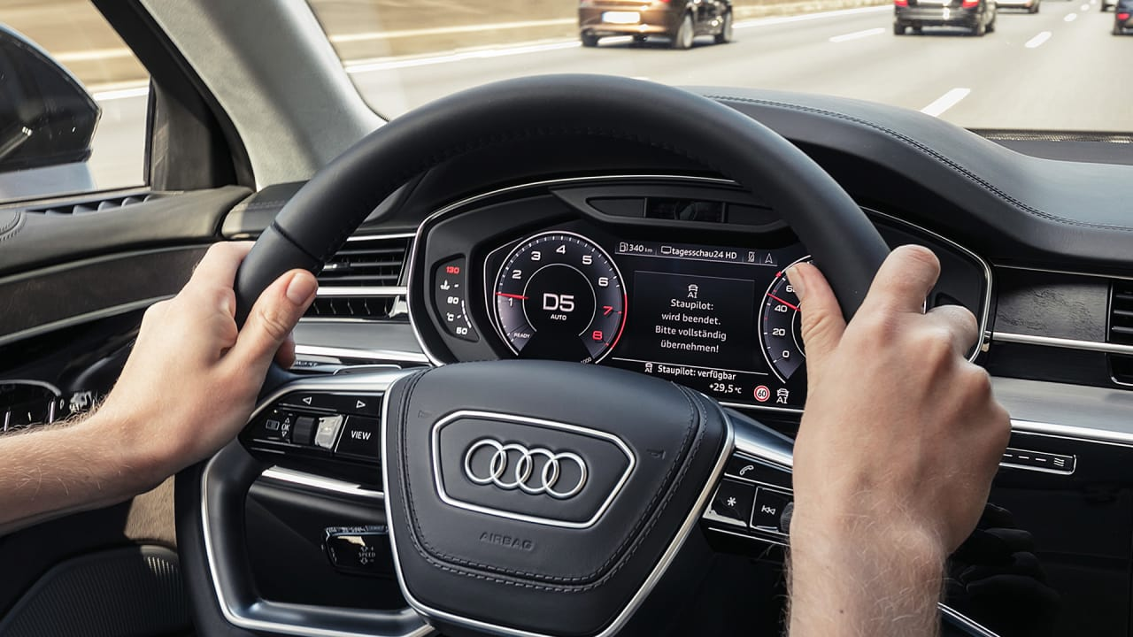
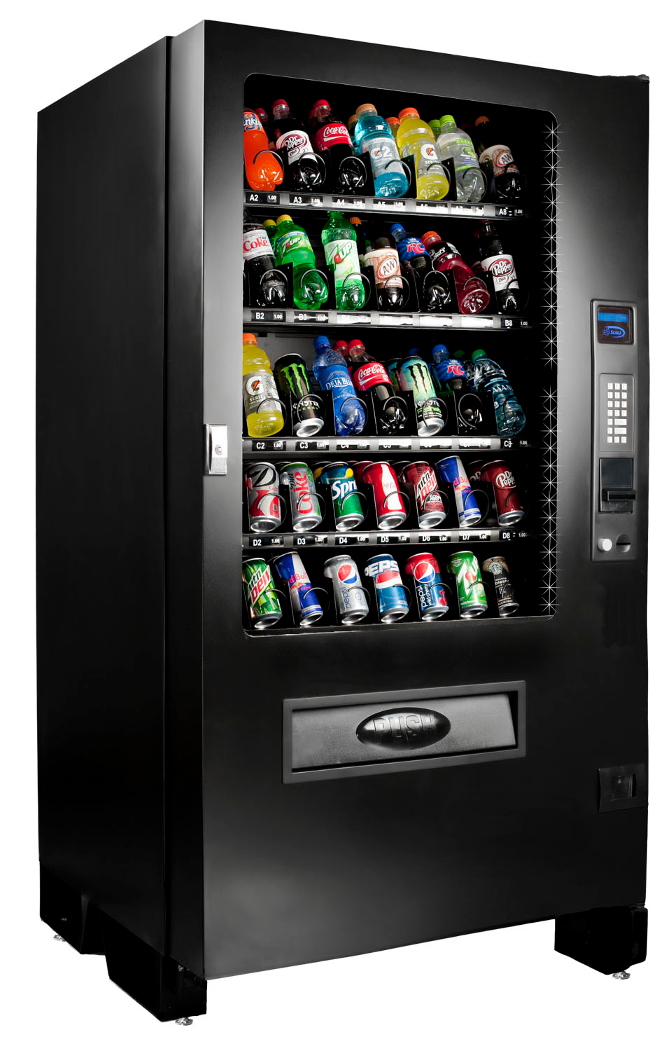
Carro
Máquina de refrigerante

Slide 7
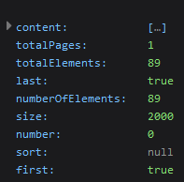
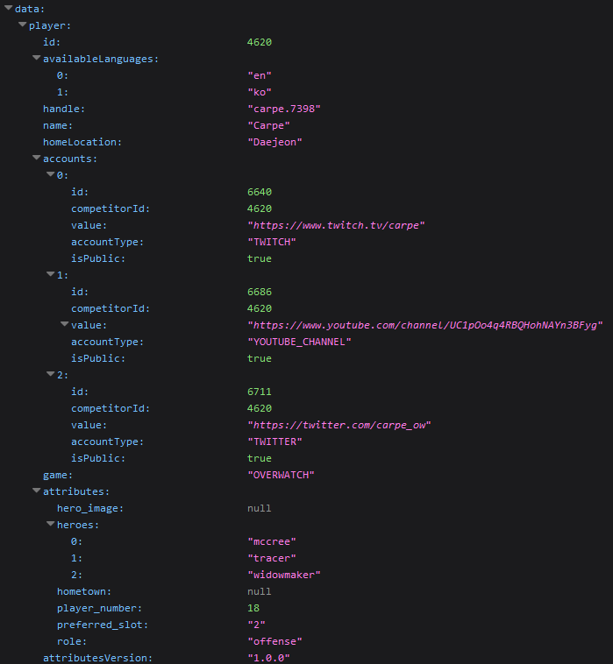
https://api.overwatchleague.com/players
https://api.overwatchleague.com/players/4620

Slide 8
Representational State Transfer
Rest
É muita coisa.
Notes:
ESTILO ARQUITETURAL

Slide 9
Cliente - Servidor
Verbos HTTP
GET
Cache
POST
PUT
PATCH
Stateless
DELETE

Slide 10
Interface uniforme
Identificação de recursos
https://api.overwatchleague.com/players/4620
Manipulação de recursos
Uso de URI e dos verbos HTTP
Mensagens auto-descritivas
Uso de MIME types
HATEOAS
Navegação pelo próprio meio

Slide 11
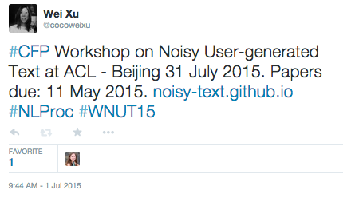
E se eu quisesse pegar um refrigerante e um salgado ao mesmo tempo?
Ou retornar os jogadores e os mapas do jogo para mostrar na mesma tela?
{"favorited": false, "contributors": null, "truncated": false, "text": "#CFP Workshop on Noisy User-generated Text at ACL - Beijing 31 July 2015. Papers due: 11 May 2015. http://t.co/rcygyEowqH #NLProc #WNUT15", "possibly_sensitive": false, "in_reply_to_status_id": null, "user": {"follow_request_sent": null, "profile_use_background_image": true, "default_profile_image": false, "id": 237918251, "verified": false, "profile_image_url_https": "https://pbs.twimg.com/profile_images/527088456967544832/DnclpoZO_normal.jpeg", "profile_sidebar_fill_color": "DDEEF6", "profile_text_color": "333333", "followers_count": 226, "profile_sidebar_border_color": "C0DEED", "id_str": "237918251", "profile_background_color": "C0DEED", "listed_count": 13, "profile_background_image_url_https": "https://abs.twimg.com/images/themes/theme1/bg.png", "utc_offset": null, "statuses_count": 120, "description": "I am a postdoctoral researcher @PennCIS, studying Natural Language Processing and Social Media.", "friends_count": 166, "location": "Philadelphia PA", "profile_link_color": "0084B4", "profile_image_url": "http://pbs.twimg.com/profile_images/527088456967544832/DnclpoZO_normal.jpeg", "following": null, "geo_enabled": true, "profile_background_image_url": "http://abs.twimg.com/images/themes/theme1/bg.png", "name": "Wei Xu", "lang": "en", "profile_background_tile": false, "favourites_count": 88, "screen_name": "cocoweixu", "notifications": null, "url": "http://www.cis.upenn.edu/~xwe/", "created_at": "Thu Jan 13 23:15:12 +0000 2011", "contributors_enabled": false, "time_zone": null, "protected": false, "default_profile": true, "is_translator": false}, "filter_level": "low", "geo": null, "id": 616333141884674048, "favorite_count": 0, "lang": "en", "entities": {"user_mentions": [], "symbols": [], "trends": [], "hashtags": [{"indices": [0, 4], "text": "CFP"}, {"indices": [124, 131], "text": "NLProc"}, {"indices": [132, 139], "text": "WNUT15"}], "urls": [{"url": "http://t.co/rcygyEowqH", "indices": [99, 121], "expanded_url": "http://noisy-text.github.io", "display_url": "noisy-text.github.io"}]}, "in_reply_to_user_id_str": null, "retweeted": false, "coordinates": null, "timestamp_ms": "1435780246598", "source": "<a href=\"http://twitter.com\" rel=\"nofollow\">Twitter Web Client</a>", "in_reply_to_status_id_str": null, "in_reply_to_screen_name": null, "id_str": "616333141884674048", "place": null, "retweet_count": 0, "created_at": "Wed Jul 01 19:50:46 +0000 2015", "in_reply_to_user_id": null}
Underfetching
Overfetching

Slide 12
GraphQL
GraphQL
Uma nova forma.

Slide 13
Único endpoint
https://api.overwatchleague.com/graphql

Slide 14
{
"data": {
"user": {
"id": 2,
"login": "user_1",
"lastLoginAt": "2012-04-23T18:25:43.511Z"
}
}
}
query {
user(id: 2) {
id
login
lastLoginAt
}
}

Slide 15
O cliente sabe quais dados ele deve mostrar
Economia na transferência de dados
Deprecation
Introspection
Schema Stitching

Slide 16
Schema exposto
Você já usa Rest
Cache
Tratamento de erros
Queries maliciosas

Slide 17
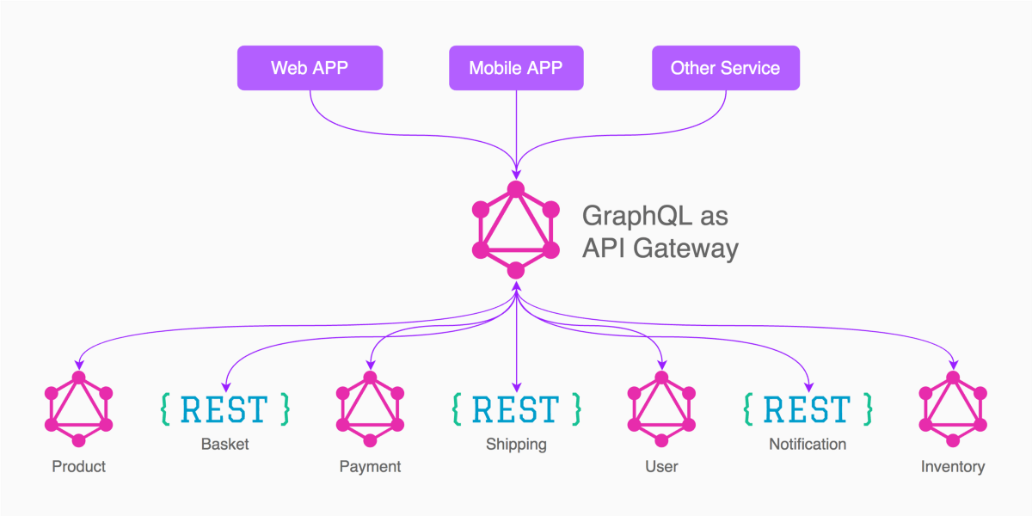
Microsserviços
Produtos pequenos

Slide 18
Dúvidas?

Slide 19
Obrigado!

